Slide 1
Law, Ethics, and Privacy
Lesson Introduction
Understand laws that are relevant to cyber security.
Learn about professional and ethical conduct in the context of cyber security.
Gain an understanding of privacy challenges in the online world.
Notes:
Headshot

Slide 2
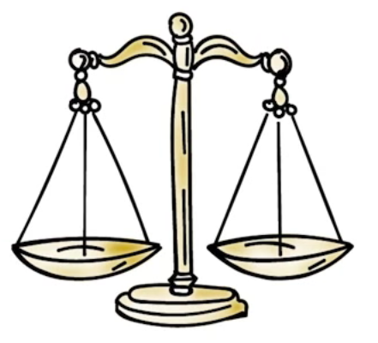
US Laws Related to Online Abuse
Cyber crime
Data theft, identity theft, extortion etc.
Copying and distribution of digital objects (software, music)
Copyrights, patents, trade secrets.
How are these applicable in the context of digital/computer objects?
Privacy
Who can collect my information, how can I control it, how could it be used etc.?

Slide 3

Legal Deterrents Quiz
Technology and other safeguards for cyber security are largely defensive in nature. The only way they can impact a threat source is by increasing the work factor for an attacker. Can laws be used to reduce the magnitude of threats? Choose the best answer:
Yes, laws can provide criminal sanctions against those who commit cyber crime
No, cyber crime has increased even as new laws have been put in place.
Notes:
QUIZ:
Discuss
---
SOLUTION:
Discuss

Slide 4
Cost of Cybercrime Quiz
Choose the best answer.
Cyber crime is a big problem. According to a recent report, what is an estimate of the cost of cybercrime for the United States?
Ten billion dollars
Over hundred billion dollars
Notes:
QUIZ:
Discuss
---
SOLUTION:
Discuss

Slide 5
US Computer Fraud and Abuse Act (CFAA)
Defines criminal sanctions against various types of abuse
Unauthorized access to computer containing:
data protected for national defense
banking or financial information
Unauthorized access, use, modification, destruction, disclosure of computer or information on a system operated by or on behalf of US govt.

Slide 6
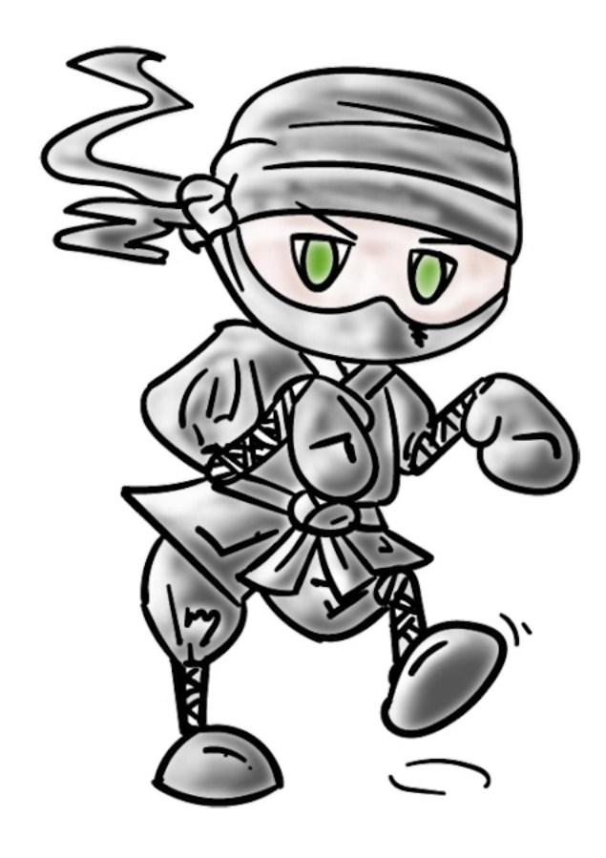
US Computer Fraud and Abuse Act (CFAA)
Accessing without permission a protected computer (any computer connected to the Internet)
Transmitting code that causes damage to computers (malware)
Trafficking in computer passwords

Slide 7
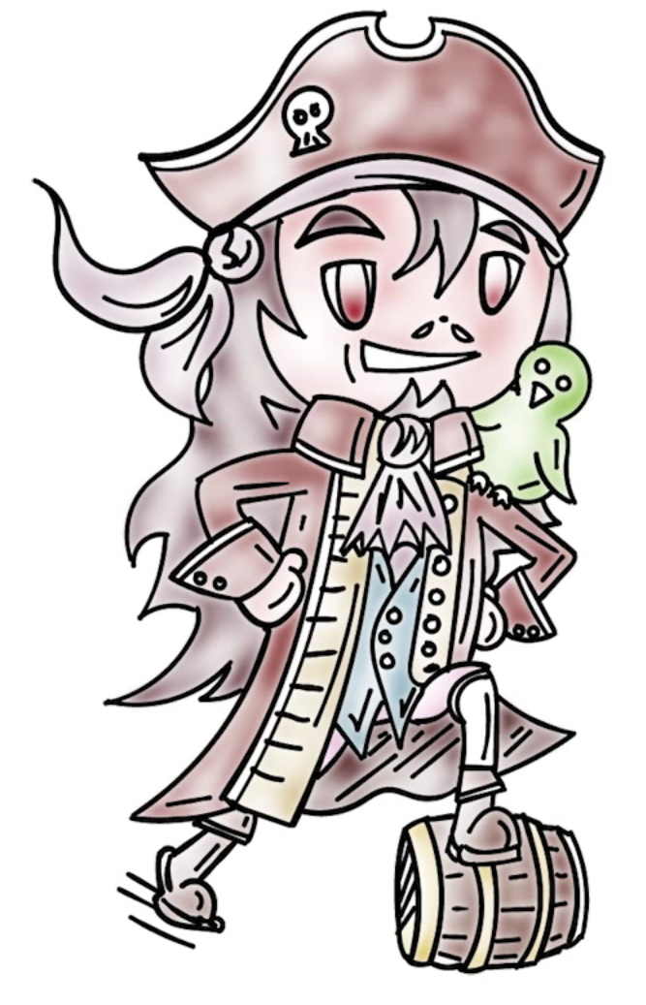
Digital Millennium Copyright Act
(Intellectual Property: Music, software piracy)
Digital objects can be copyrighted.
It is a crime to circumvent or disable anti piracy functionality built into an object.
It is a crime to manufacture, sell, and distribute devices that disable anti piracy functionality or copy objects.

Slide 8
Digital Millennium Copyright Act
(Intellectual Property: Music, software piracy)
Research, educational exclusions (e.g., libraries can make up to three copies for lending).
RIAA lawsuits & P2P music sharing – electronic frontier foundation

Slide 9
Computer Abuse Laws Enforcement
Challenges:
Enforcement is difficult
Attribution is hard (evidence collection, forensics etc.)
Transnational nature of the Internet
Cyber criminal ecosystem evolves to undermine legal safeguards

Slide 10
Melissa Virus Quiz
The Computer Fraud and Abuse Act was used to prosecute the creator of the Melissa virus and he was sentenced in federal prison and fined by using its provisions. What abuse was perpetrated by the Melissa virus? Choose the best answer.
Data stored on computers was destroyed.
Denial-of-service attacks that made computers unusable
Notes:
QUIZ:
Discuss
---
SOLUTION:
Discuss

Slide 11
Unauthorized Access Quiz
Several people have argued about the overly general and vague language of the CFAA. For example, how exactly is unauthorized access defined? In one case, a company sued its competitor because the competitor’s employees created a trial subscription and downloaded data that was available to its subscribers. Do you think this is violation of unauthorized access? Choose the best answer.
No, the data was publicly available
Yes, because it potentially can cause financial loss to the company that sued its competition.
Notes:
QUIZ:
Discuss
---
SOLUTION:
Discuss

Slide 12
DMCA Exclusions Quiz Solution
Choose the best answer.
The DMCA includes exclusions for researchers but companies have threatened to sue researchers who wanted to publish work related to circumvention of anti-piracy technologies. Which of these is an example of such a threat under DMCA?
Prof. Ed Felten’s research on audio watermarking removal by RIAA
A research project done by MIT students that found vulnerabilities in the Boston Massachusetts Bay Transit Authority (MBTA).
Notes:
QUIZ:
Discuss
---
SOLUTION:
Discuss

Slide 13
Ethical Issues
Difference between law and ethics
Individual standard vs. societal
No external arbiter and enforcement unlike law
Examples – What do you do when you discover a vulnerability in a commercial product? Ethical disclosure?
Code of ethical conduct (IEEE, ACM, university)

Slide 14
Computer Ethics Quiz
Choose the best answer.
By mistake, a friend sends sensitive health data in an email to you (wrong attachment). You should not read the information in the attached document because...
Professional code of ethics requires you to respect privacy of others.
You can be liable under CFAA.
Notes:
QUIZ:
Discuss
---
SOLUTION:
Discuss

Slide 15
Responsible Disclosure Quiz
Choose the best answer.
US_CERT follows a responsible disclosure process for vulnerabilities reported to it. Such a process must...
Make the vulnerability information available to everyone who may be affected by it immediately,
Provide a certain period of time for the vendor of the vulnerable system to develop a patch.
Notes:
QUIZ:
Discuss
---
SOLUTION:
Discuss

Slide 16

Privacy
Definition: A user’s ability to control how data pertaining to him/her can be collected, used and shared by someone else.

Slide 17
Privacy
Privacy is not a new problem.
People have always worried about what others (friends, enemies, governments) might know about what they do.
Scale and magnitude at which information about us and our activities can be collected, ways in which it can be used, and shared or sold.

Slide 18
Privacy
What is private?
Financial statements, credit card statements, banking records etc.
Health/medical conditions
Legal matters
Biometrics (e.g., fingerprints)
Political beliefs
School and employer records
Web browsing habits? What do we search, what do we browse? Websites we visit?
Communication (emails and calls)
Past history (right to be forgotten)

Slide 19
Privacy
What is not private?
Where I live? My citizenship?
I am registered to vote? (US)
My salary (state employee because Georgia Tech is a public university)

Slide 20

Privacy
Do we need privacy only for individuals?
Universities, hospitals, charities require privacy and need to protect data of people they serve or have as employees.

Slide 21
Right to Be Forgotten Quiz
In 2014, the European Court of Justice ruled that EU citizens have the “right to be forgotten” on the Internet. For example, Google must not return links to information that can be shown to be "inaccurate, inadequate, irrelevant or excessive". Which one of the following is an example of information that Google decided not to return as a search result to meet the ECJ ruling? Choose the best answer.
Story about criminal conviction that was quashed on an appeal
A doctor requesting removal of links to newspaper stories about botched procedures performed by him
Notes:
QUIZ:
Discuss
---
SOLUTION:
Discuss

Slide 22

Threats to Privacy
Traffic analysis (we know who you talk to)
Surveillance (scale and magnitude – cameras everywhere, Snowden disclosures)
Linking and making inferences (big data, data mining, analytics)

Slide 23
Threats to Privacy
Social media (we know your friends)
Tracking of web browsing (cookies)
Location aware applications (we know where you have been)
Sometimes we are willing parties (loyalty cards in stores)

Slide 24
Privacy Threats to Online Tracking Info
Collection of information about you (e.g., tracking) – with or without your consent?
Usage – only used for specified purpose you agreed to?
Information retention – how long can they keep it?
Information disclosure and sharing – disclosed to only authorized or agreed to parties?
Privacy policy changes – can information collector/holder change to a more lax policy without your agreement?
Information security – identity and access management, monitoring, secure against various threats we discussed.

Slide 25
Example: Google Privacy Policy
What information is collected about you?
Personal information like name, email address, credit card, telephone number etc. that we provide to create an account. Profile?
Services we visit a certain a website. Use it for advertising.
Device information: hardware model, OS, network information (IP address) etc.
Search queries
Who we call? For long we talk?
Cookies
Location information
Applications

Slide 26

Example: Google Privacy Policy
How is collected information used?
Improve user experience (personalization)
For serving you targeted advertisements (this is how they make their money) – we can set ad preferences.

Slide 27
Example: Google Privacy Policy
Who do they share it with?
With opt-in, can share with companies, individuals and organizations outside of Google.
Domain administrators and resellers who provide user support to your organization can get certain information about you that you give to Google.
Affiliates and other trusted businesses or persons with appropriate confidentiality and security measures.
For legal reasons.

Slide 28
Example: Google Privacy Policy
Information security
Many services use encryption
Stronger authentication (two factor)
Other safeguards
Changes to privacy policy
Will not reduce user rights without your consent

Slide 29
EFF Quiz
Check all that apply:
The Electronic Frontier Foundation (EFF) ranks websites with privacy scores based on how they deal with issues related to privacy. It gave AT&T one of the lowest scores (just one out of five stars). What explains this low score?
Does not disclose data retention policies
Does not use industry best-practices
Does not tell users about government data demands
Notes:
QUIZ:
Discuss
---
SOLUTION:
Discuss

Slide 30
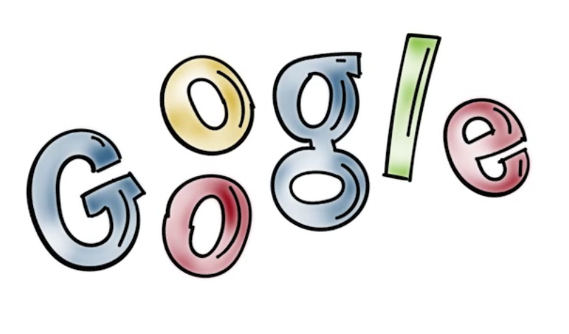
Google Privacy Policy Quiz
Choose the best answer.
Does Google privacy policy disclose data retention policy?
Yes
No
Notes:
QUIZ:
Discuss
---
SOLUTION:
Discuss

Slide 31
Legal Deterrents Quiz
Mark all applicable answers.
Poor privacy is good for bad guys because they can use information about you to craft...
Targeted phishing attacks
Gain access to your online accounts
Notes:
QUIZ:
Discuss
---
SOLUTION:
Discuss

Slide 32

Facebook Privacy Policies
Not really, Facebook had issues and actually the United States Federal Trade Commission went after it for violation of user privacy.
Do companies adhere and operate according to the privacy policy you gave consent to?

Slide 33
Facebook Privacy Policies
What did it do or did not do?
Made information users designated as private – friend list – public without consent
Made personal information available to applications of friends
Shared information with advertisers that it had promised not to share
Verified apps were not really verified

Slide 34
FTC Sanctions
Consequences of privacy policy violation:
3rd party privacy audits every 2 years for the next 20 years
Prohibited from misrepresenting privacy and security setting provided to consumers
Obtain affirmative express consent before sharing user information in a way that exceeds their privacy settings

Slide 35
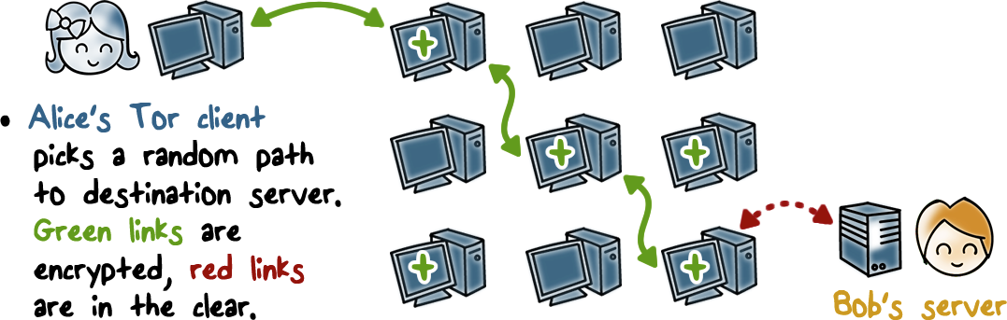
Privacy Enhancing Technologies
Tor (network traffic analysis would not allow someone to know where we are coming from)
Alice does not want web service to know she is accessing it.

Slide 36
Privacy Enhancing Technologies
TOR: Onion routing is the basic idea
With the help of a directory service, get a set of nodes
Random set and order
Alice prepares a message and creates onion layers with encryption
Pseudo-anonymity (fake or fictional identities), multiple identities etc.
Aggregation, privacy enhancing transformations (generalization, anonymizing, diverse data values etc.)

Slide 37

Controlling Tracking on the Internet
Third party cookie blocking
Do not track
Clearing client’s state
Blocking popups
Private browsing

Slide 38
Fandango Quiz
Choose the best answer.
The FTC charged Fandango, the online movie ticket purchasing company, for not protecting user privacy. This action was taken because Fandango...
shared user data without informing users
did not secure user data
Notes:
QUIZ:
Discuss
---
SOLUTION:
Discuss

Slide 39
Tracking Quiz
Choose the best answer.
If a company tracks your activities based on your machine’s IP address. One possible defense against it is...
Disable cookies
Use Tor
Notes:
QUIZ:
Discuss
---
SOLUTION:
Discuss

Slide 40
Law, Ethics, and Privacy
Lesson Summary
Computer fraud and abuse laws aim to go after malicious actors but many of their provisions have led to plenty of debate
Ethical standards and professional code of conduct specifies what online activities are out of bounds.
Online privacy is a huge issue for many but we do not seem to have much of it.
Notes:
Headshot

